Slide 1



Blinkit Sales Dashboard
Retail Performance Analysis using Excel
By: NUKUL SINGH

Slide 2
List of Content
Excel Tools Used
Dashboard
Summary of Data Analyses
Skill Learned
Acknowledgment

Slide 3
Excel Tools Used
Donut Chart
Bar Chart
Stacked Column Chart
Line Chart
Donut/ Pie Chart
Funnel Map
Matrix Card

Slide 4
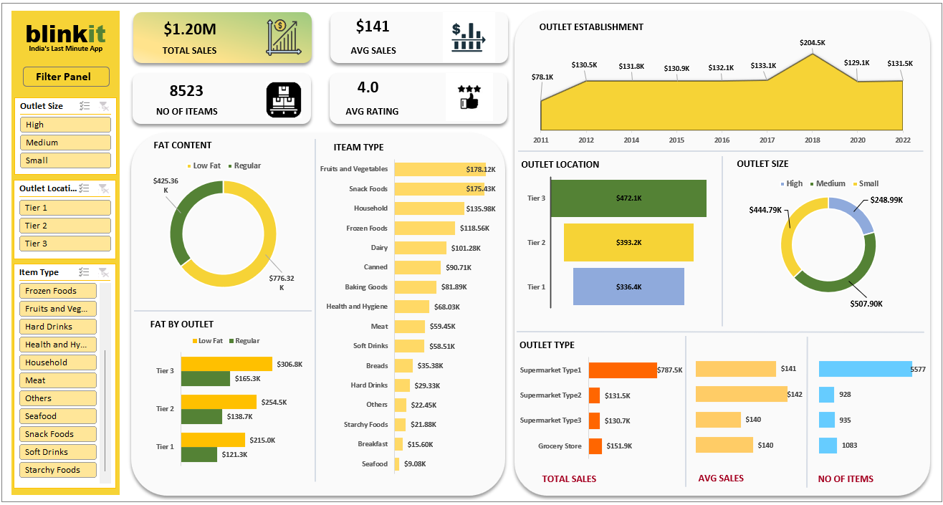
Dashboard Snippets

Slide 5
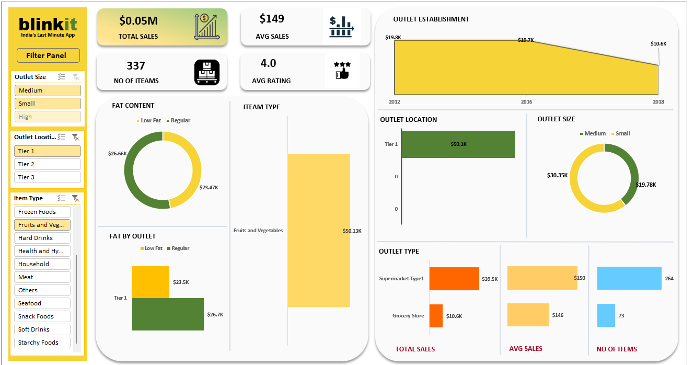
Dashboard Snippets

Slide 6
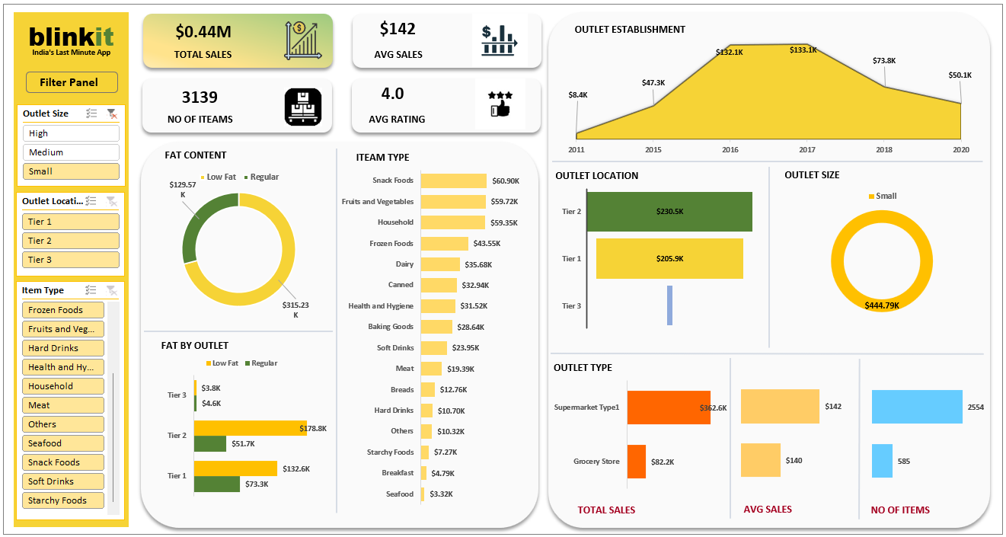
Dashboard Snippets

Slide 7
blinkit Analysis
BUSINESS REQUIREMENT
To conduct a comprehensive analysis of Blinkit’s sales performance, customer satisfaction, and inventory distribution to identity key insights and opportunities for optimization using various KPI’s and visualization in Excel.
KPI’s Requirement
Total Sales: The overall revenue generated from all items sold.
Average Sales: The overall revenue per sale.
Number of Items: The total count of different items sold.
Average Rating: The average customer rating for items sold.

Slide 8
blinkit Analysis
BUSINESS REQUIREMENT
Chart’s Requirement
Total Sales by Fat Content:
Objective: Analyze the impact of fat content on total sales.
Additional KPI Metrics: Assess how other KPI’s (Average Sales, Number of items, Average Rating) vary with fat content.
Chart Type: Donut Chart.
Total Sales by Item Type:
Objective: Identity the performance of different item in terms of total sales.
Additional KPI Metrics: Assess how other KPI’s (Average Sales, Number of items, Average Rating) vary with fat content.
Chart Type: Bar Chart
Fat Content by Outlet for Total Sales:
Objective: Compare total sales across different outlets segment by fat content.
Additional KPI Metrics: Assess how other KPI’s (Average Sales, Number of items, Average Rating) vary with fat content.
Chart Type: Stacked Column Chart
Total Sales by Outlet Establishment:
Objective: Identity the performance of different item in terms of total sales.
Chart Type: Line Chart

Slide 9
blinkit Analysis
BUSINESS REQUIREMENT
Chart’s Requirement
Sales by Outlet Size:
Objective: Analyze the correlation between outlet size and total sales.
Chart Type: Donut/ Pie Chart
Sales by Outlet Location:
Objective: Assess the geographic distribution of sales across different locations.
Chart Type: Funnel Map.
All Metrics by Outlet Type:
Objective: Provide a comprehensive view of all key metrics (Total Sales, Average Sales, Number of items, Average Rating) broken down by different outlet types.
Chart Type: Matrix Card

Slide 10
Skill Learned
Analyzing large data set and finding out key performance indicators which you have to present on dashboard.
How to categorized data in different way like Chart, Table etc.
How to use Slicer in Excel
DAX Function

Slide 11
Acknowledgement
I would like to express my special thanks of gratitude to my teacher “Mr. Diwakar sir” at DUCAT IT TRAINING school for providing us with the appropriate skills to be able to present this project theme – Blinkit Grocery Data with the utmost confidence and knowledge. It help me in increasing my Excel domain knowledge and skills in analysing data.

Slide 12
THANK YOU

